Slide 1
Submitter 77 - Economics
December 2023
Prepared by Tamba Carleton

Slide 2
Supply occurs in areas with amenity
  Auckland market apartment supply since the Unitary Plan
 | Areas/suburbs | Number of projects | Proportion of total | Number of units
City centre | 1 | 31 | 15% | 3,572
Metropolitan centre | 10 | 28 | 14% | 1,773
Town centre | 35 | 83 | 40% | 3,214
Outside of group | 28 | 64 | 31% | 2,628
High amenity (retail) | 6 | 12 | 6% | 814
City fringe | 7 | 28 | 14% | 1,235
Coastal | 8 | 17 | 8% | 339
Other outside of group | 7 | 7 | 3% | 240
Total | 74 | 206 | 100% | 11,187
 |  |  |  | Source: CBRE
206 Auckland market apartment projects completed since the Unitary Plan
69% of projects are in key zones
28% are in locations of high amenity
In total 97% of supply has been directed at urban centres or locations with special attributes

Slide 3
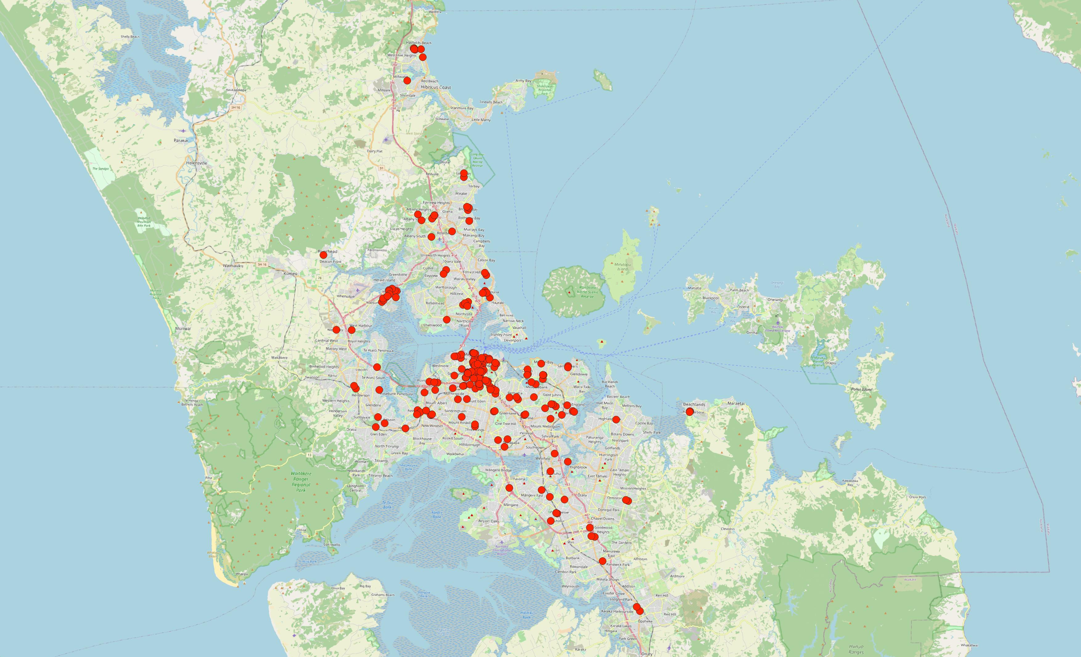
Zoning for intensive apartment development doesn’t make it happen
  Auckland market apartment supply since the Unitary Plan
Supply is concentrated in and around the urban core and some key highly amenitised suburban centres
Zoning for intensification does not create end user market demand nor does it redirect it away from areas with higher existing amenity
There are multiple examples of far flung Metropolitan Centres that are still not seeing apartment supply

Slide 4
High rise apartments are challenging
  Abandonment rate of market apartments in Auckland in the last 5 years
It is easier for the market to deliver low rise apartments than high rise apartments
Construction costs are lower which makes a dwelling price point more competitive
Scale tends to be lower allowing faster sell down
More developers and builders have the capability and resources to do them
Queenstown has several examples of projects by credible developers that have failed

Slide 5
They tend to need carparks
  Motor vehicle ownership of owner occupier households in urban Queenstown – Census 2018
Owner occupiers of apartments typically own at least one car
Developers respond by providing sufficient carparking
Owner occupier projects in Auckland CBD have a carparking ratio of 1.11 per unit
For suburbs outside the urban centres its 1.31 per unit
Structured carparking is expensive. For Auckland projects, at grade is around $30,000 to $40,000 and structured is around $70,000 to $100,000.

Slide 6
The market is price sensitive
  Pricing of market apartments in Auckland
 | Average $/sqm of projects completed or underway | Average $/sqm of abandoned projects | Difference
Walk ups (2-3 storey) | $10,883 | $12,260 | 13%
High rise (7+ storey) | $15,262 | $18,605 | 22%
 |  |  | Source: CBRE
Walk ups are 30-35% cheaper than high rise
Abandonments are priced 13-22% higher than the average $/sqm of successful projects
This emphasises the importance of cost on development feasibility
Structured carparking adds to what is an already high development cost

Slide 7
Allowing RVA increases feasibility
  Indicative annual rental revenue for Queenstown dwellings
The indicative annual revenue for long term rental is $40,000 per year compared to short term rental at $157,000 per year
Banning RVA directs investor demand toward projects which have consent allowing this
This reduces the investor presales and restricts supply
In the Economics JWS, 5 of the 6 experts agree that RVA as defined in the PDP increases development feasibility

