Slide 1
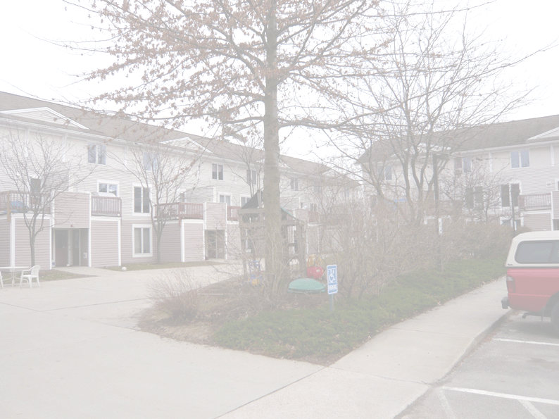

Community land trusts and affordability retention
Dr Louise Crabtree
Institute for Culture and Society
Western Sydney University

Slide 2

Introduction and Overview
Private, non-profit organisations holding diverse portfolios of properties in perpetuity. Twin aims:
Community benefit, and
Perpetual affordability
What do these mean, and
What do these mean for Queenstown?
Notes:
1 is our governance question
2 relates to models of tenure and resale formula
3 is up to you – what do these mean locally?

Slide 3

1/3. Community benefit
Community control and input
Member-based organisations
Members pay annual fees, can run for Board and sub-committees
Board structure 1:1:1 to balance interests
1/3rd elected members from residents of CLT homes
1/3rd elected members from non-resident members of community
1/3rd appointed by the other 2/3^{rds} according to need
All prospective Board members receive the same training; capacity building and shared goals/understanding of position of role

Slide 4

1/3. Community benefit
Community control and input
Whether community (however defined) owns the organisation and/or has presence in governance
Rights and presence of community are enshrined in organisational form, documents, policies, and processes
Keeping assets in community hands with community voice and investment/sense of ownership
Can be strategically important in terms of dealing with resistance to affordable housing
Skills-based appointments where required
Diversity of programs as a result of diversity and dynamism of Board
Notes:
Relevant community
Place based
Sociocultural cohort – ethnic, religious, gender/sexuality, household structure…
Economic profile
Governance
Ownership or title – how secure is this?
On Board, sub-committees
Perpetuity
Ongoing presence of diverse stakeholders means diversity of programs, greater support for organisation and affordable housing developments
Also highlights need for appropriate organisational forms and documents
Fall back positions if organisation folds
Examples of governance outcomes
E.g., support for or provision of community and/or commercial facilities – e.g.., Food Project, community childcare centres, medical centre, queer space, refugee centre, food shelf, meals centre…
Aims in structuring governance entity?
Resident representation, local allies, addressing NIMBYism…

Slide 5

1/3. Community benefit
Case Study. Dudley Street Neighbourhood Initiative, Boston
Member-based planning and organising entity
“a collaborative effort of over 3,000 residents, businesses, non-profits and religious institutions members ” (http://www.dsni.org/history.shtml)
Board of 34 across diverse groups, including youth
Established a community land trust (DNI) at arm’s length to develop and deliver affordable housing
Has overseen development of 225 units of perpetually affordable homes by their CLT, plus over 1,300 local development applications, often with several hundreds members in attendance. Open space, community and commercial facilities.
DNI’s strategic vision for the area has been adopted by the City as local urban renewal plan

Slide 6

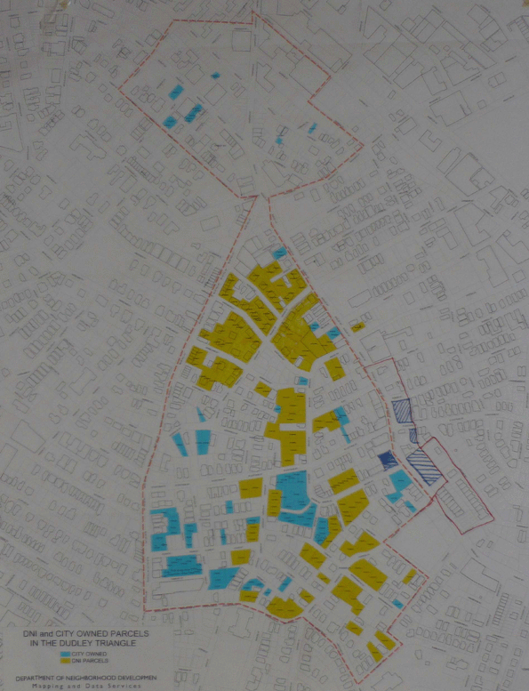
DNI Board (11 seats)
3 non-voting appointed reps
1 by City Councilor from the 7th District
1 by State Senator of the 2nd Suffolk District
1 by the State Representative of the 5th Suffolk House District
8 voting positions
6 are from DSNI (3 lessees)
1 from the Roxbury Neighborhood Council
1 from the Mayor’s office
Notes:
12ha core area
Blue = City land
Yellow = DNI land
CLT is the tool of the larger CDC and implements its development vision
Non-voting members are observers
Diversity of activities as result of diversity and dynamism of Board

Slide 7
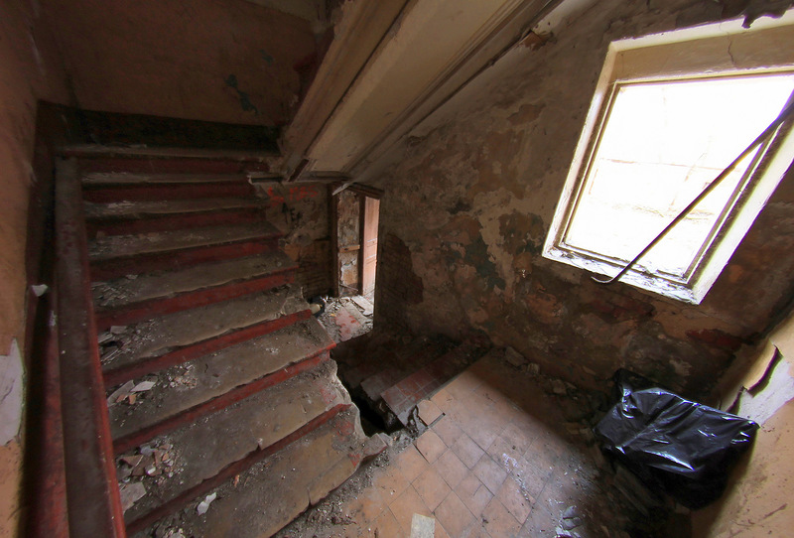
1/3. Community benefit
Champlain Housing Trust, Burlington VT
currently largest CLT in US, operate over three counties
Over 4,000 voting members; 1,600 rental units, 600 owner-occupied homes, 100 cooperative housing units
Aged care, child care, food shelf, kitchen, refugee centre, queer/safe space, Abenaki cultural centre, Good News Garage, Bike Recycle Vermont, Vermont Legal Aid, housing finance advice centre…
Established by City with start-up funding. City invests staff pensions in the Trust, plus diverts some of the local AH tax levy to the Trust.
Notes:
Friendly but independent relationship with the City.
Diversity of Board has led to immense diversity of programs.

Slide 8

1/3. Community benefit
Port Phillip Housing Trust
Formed in 2005; transfer of 12 City of Port Phillip properties worth $49.2m in 2007 to protect properties from sell-off
Port Phillip Housing Association set up in 1985 to manage affordable rental properties in the area
Manages over 700 properties
Is now nominated Trustee of PPHT
Rentals only
Notes:
Options for arms-length governance

Slide 9

1/3. Community benefit
Existing or new organisation?
Benefit from the capacity and networks of existing organisation vs the ability to build from the grassroots
Issue of legitimacy and trust can swing either way
Community involvement?
In/flexibility
Are the objectives permissible within the existing organisation’s remit and legal form?
Future
Remain as program, arm’s length, or become a separate entity?
Notes:
New organisation may have more or less legitimacy and trust amongst stakeholders
Does existing org have baggage or bad reputation?
Would independence from that organisation be valuable?
Flexibility
Are there tax implications? Australian e.g. of charity status

Slide 10

Immediate questions?

Slide 11

2/3. Perpetual affordability
A. Tenure options
Range of mechanisms for delivering housing stability
Depends on what is legally possible and your objectives
Rental via longterm renewable leases
Owner occupation as co-owners
Both can allocate equity, rights, and responsibilities between resident and organisation
Leases can also be tailored for minimal equity input so act like rentals but with stability and inheritability
Notes:
Affordability
Ongoing affordability may flag construction issues to help lower occupancy costs, costs of R&M
Reduce costs to resident and organisation if organisation has R&M responsibility
Also, organisation is there in perpetuity so doesn’t want a high maintenance asset or a reputation for bad quality
Balancing act in equity formula
Longer or shorter stays
Flat (eg., CPI), set proportion of gain, or itemised – most opt for set proportion, but depends on market

Slide 12
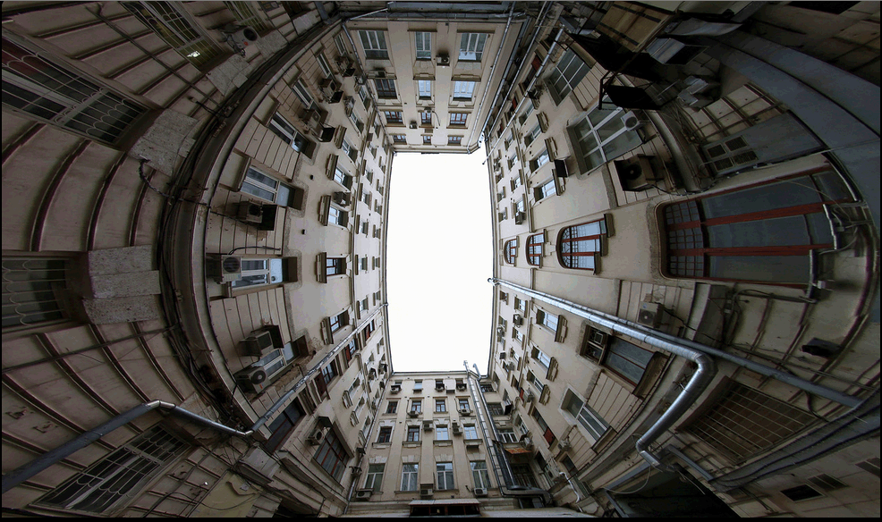
2/3. Perpetual affordability
A. Tenure options
Equity gain/restriction
Maintenance and repairs
Improvements and their equity treatment
If/how to dispose of assets
In many CLTs, this cannot be done while a legal agreement is in place, and requires a super majority vote of membership and Board
Set out in legal agreement between resident and org’n
Notes:
Equity gain vs restriction – balancing between gain to seller and retention of affordability
R&M – who does what, can vary according to household capacity, condition of stock
The asset lock is crucial, stops any stakeholders deciding to maximise their value at expense of others, including future buyers, broader community

Slide 13

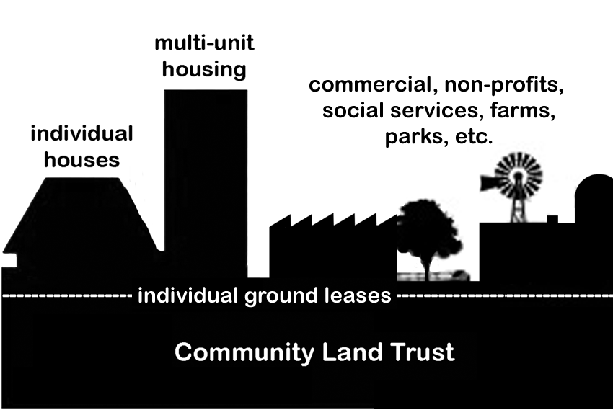
Notes:
Ideological issue of holding land value separate.
Might not achieve affordability if land component isn’t that high
Shorthand for allocating equity

Slide 14

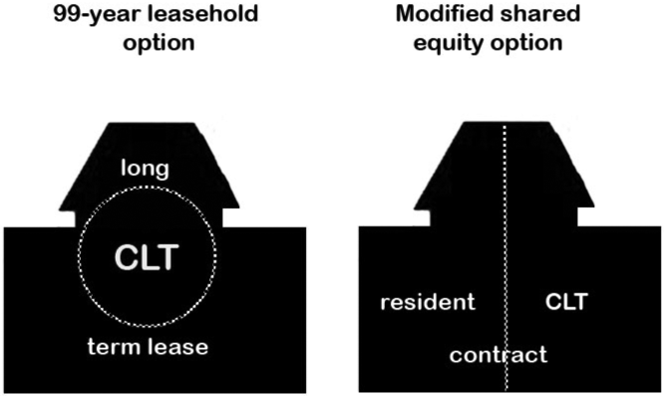
Notes:
In Australia, can’t separate these so use other mechanisms for the same outcome

Slide 15

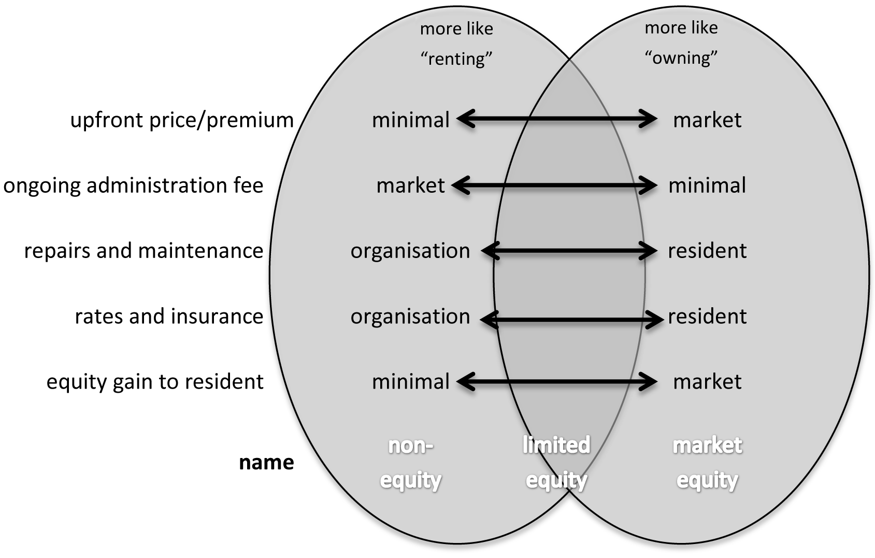
Notes:
Can place organisational settings along these axes
Don’t have to put all on the left or the right, either.

Slide 16
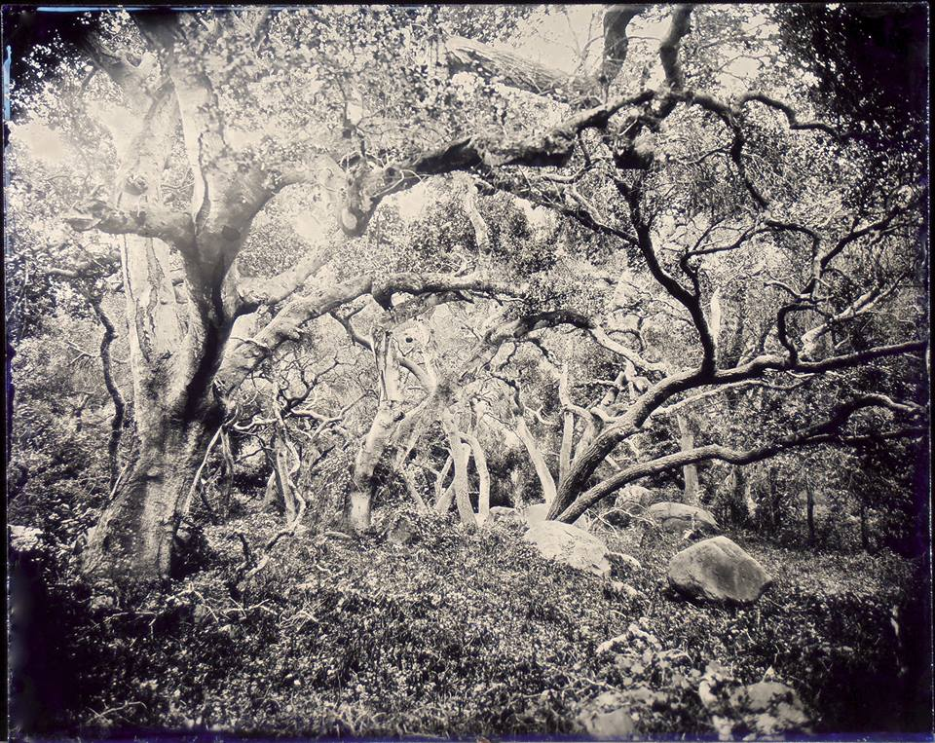
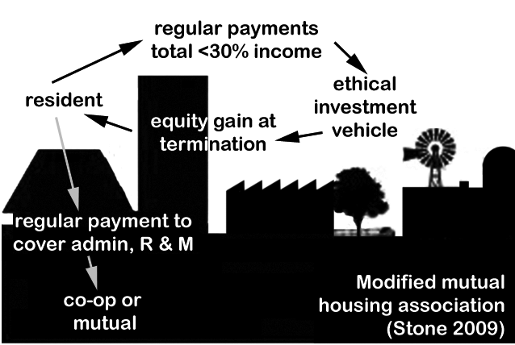
Notes:
Michael Stone’s resident-saver model; separating equity gain from tenure.

Slide 17

2/3. Perpetual affordability
B. Resale formulae (CLT Manual chapter 9)
Core principle of balancing equity gain with retention of affordability
Aims:
Foster stability, or mobility?
Incentivise improvements?
Ease of comprehension by those affected
Ease of administration
Lack of instrusiveness; sense of ownership
Avoidance of disputes
Notes:
How are community needs and objectives best met?
How determine this and maximise efficacy over time?
Legitimacy
Stability
Longevity

Slide 18
2/3. Perpetual affordability
B. Resale formulae (CLT Manual chapter 9)
Appraisal based – resident and CLT split the determined change in appraised value according to an agreed percentage – often 75:25 as CLT:resident
1a – improvements-only appraisal
1b – simple appraisal
1c – compound appraisal
Burlington Associates resale formulae comparison tool
http://www.burlingtonassociates.com/#!/resources
Notes:
How are community needs and objectives best met?
How determine this and maximise efficacy over time?
Legitimacy
Stability
Longevity

Slide 19

2/3. Perpetual affordability
B. Resale formulae (CLT Manual chapter 9)
1a. Improvements-only appraisal based
Only the building value is calculated, and a percentage of the agreed change in that value is allocated
Pros
Readily excludes increases in land value
Cons
Valuers can struggle with separating land value from built form value
No historical data

Slide 20

2/3. Perpetual affordability
B. Resale formulae (CLT Manual chapter 9)
1b. Simple appraisal based – split the increase in agreed value of home and land
Pros
Simple to apply
Historical data exists
If resident proportion is low, will retain affordability
Cons
Might not keep up with inflation
If home is deeply subsidised, might return disproportionate gain

Slide 21
2/3. Perpetual affordability
B. Resale formulae (CLT Manual chapter 9)
1c. Compound appraisal based – return percentage of agreed change in the portion that the resident has paid
Pros
Easy to apply
Fairer
Cons
Might lose affordability in hot markets
Harder to explain

Slide 22

2/3. Perpetual affordability
B. Resale formulae (CLT Manual chapter 9)
2. Fixed-rate formulae
Apply fixed rate of interest to the purchase price/premium
USA, typically range from 2-3%, compound annually
Pros
Simplest to use
Easy to predict sale price
Cons
No relationship to resident’s maintenance of home
In cool market, will lose affordability

Slide 23
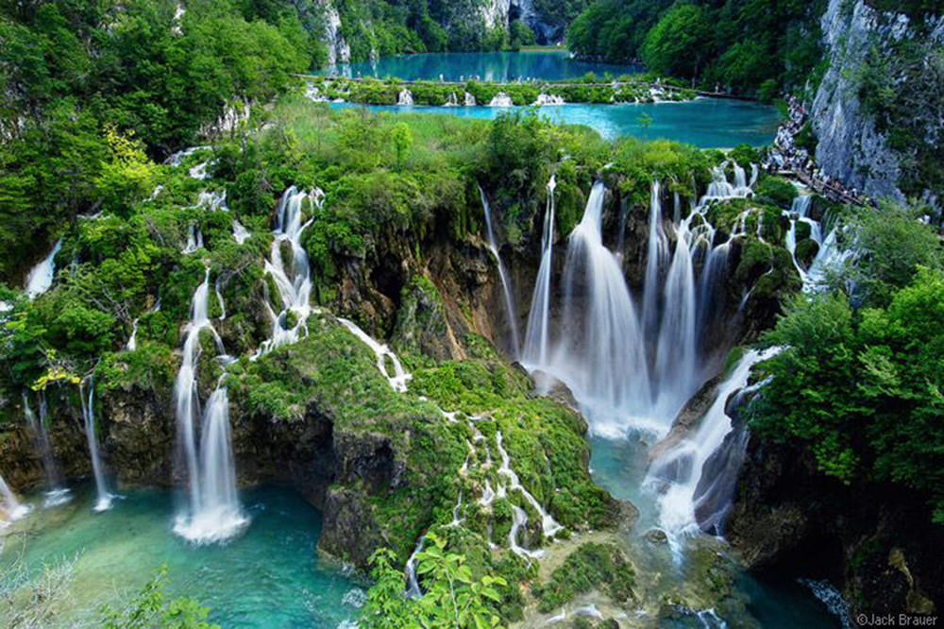
2/3. Perpetual affordability
B. Resale formulae (CLT Manual chapter 9)
3. Indexed formulae
Use a local index such as CPI or area median income (AMI)
Pros
Relatively easy to apply
Relatively predictable
Cons
No relationship to resident’s maintenance of property
Might lose affordability in cool market
If CPI or AMI are high, low income households might lose out

Slide 24

Immediate questions?

Slide 25
Trust experience and aspirations
Julie Scott, Queenstown Lakes Community Housing Trust

Slide 26

3/3 Issues for Queenstown
Afternoon tea until 3.30pm
Workshop on possibilities and issues
Reconvene at 4.40pm

Slide 27
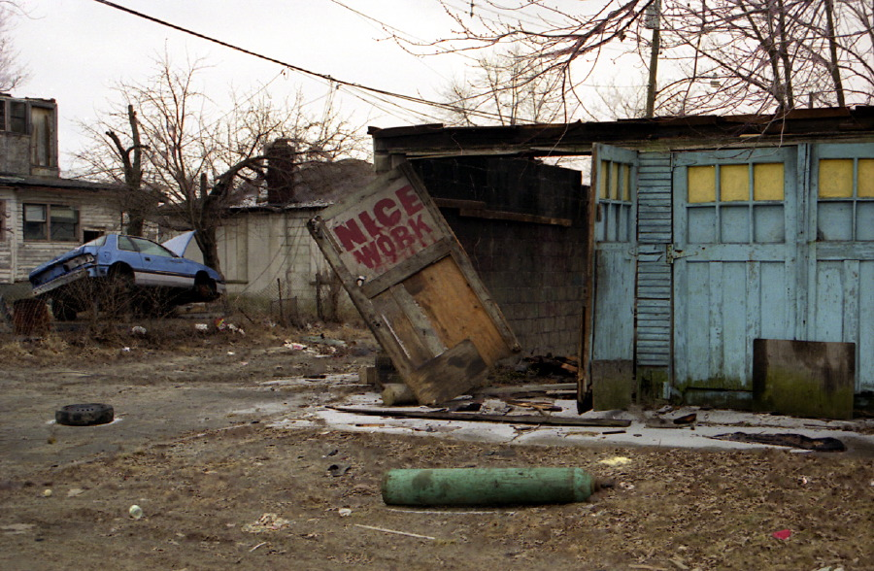
Wrap up
Reflections
What might be challenges, opportunities?
Next steps – what could these be? Who might be involved?
l.crabtree@westernsydney.edu.au

