Slide 1
QLDC Transport Network Monitoring Snapshot Report
Quarter 1 2025 / 26
1 July to 30 September 2025

Slide 2
Quarter 1 Report Overall Statement
Total cycle counts on Active Travel route counters (new counters added for 2025/26) are 77,523 trips.
Total pedestrian counts across the Active Travel route counters (new counters added for 2025/26) are 113,376 trips.
Queenstown bus patronage for 2024/25* is 1,966,086 trips – representing an increase of 4% from 2023/24.
In comparison to growth across the district, the Whakatipu area had a 1.7% increase in resident population for 2024/25 from 2023/24.
Queenstown ferry patronage for 2024/25 is 77,123 trips – representing a decrease of 4% from 2023/24.
Bus reliability in Queenstown increased from an average of 88.03% in Q4 2023/24* to an average of 91.1% in Q4 2024/25.
Traffic counts continue to increase with particularly noticeable increases at the SH6 between the BP roundabout and Airport, Kawarau Falls Bridge and SH6 south of Peninsula Rd counter sites.
* At the time of report publication, ORC have only released data on public transport through to the end of the 2024/25 financial year

Slide 3
Number of People on Bikes
New counters have come online for the new year of reporting. This means that total counts are not directly comparable to 2024/25.
Queenstown Cycle Counters Q1 total movements
Arthurs Point Trail * – 3,034
Cameron Place – 2,546 (13% ↑ on Q1 2024/25)
Frankton Beach – 9,698 (8% ↓ on Q1 2024/25)
Gorge Road – 4,276 (missing data for Q1 2024/25)
Malaghans Road – 1,114 (26% ↑ on Q1 2024/25)
Wānaka Cycle Counters Q1 total movements
Anderson Road Shared Path * – 7,058
Aubrey Road Shared Path – 14,141 (4% ↓ on Q1 2024/25)
Ballantyne Rd Golf Course * - 6,010
Ballantyne Rd SH * - 10,158
Lakeside Road – 16,369 (6% ↑ on Q1 2024/25)
Lismore Shared Path * – 3,119
Total Cycle Counts for Q1 2025/26 – 77,523
* New counter for 2025/26 reporting
Data sourced from designated Active Travel (Commuter) cycle counters.

Slide 4
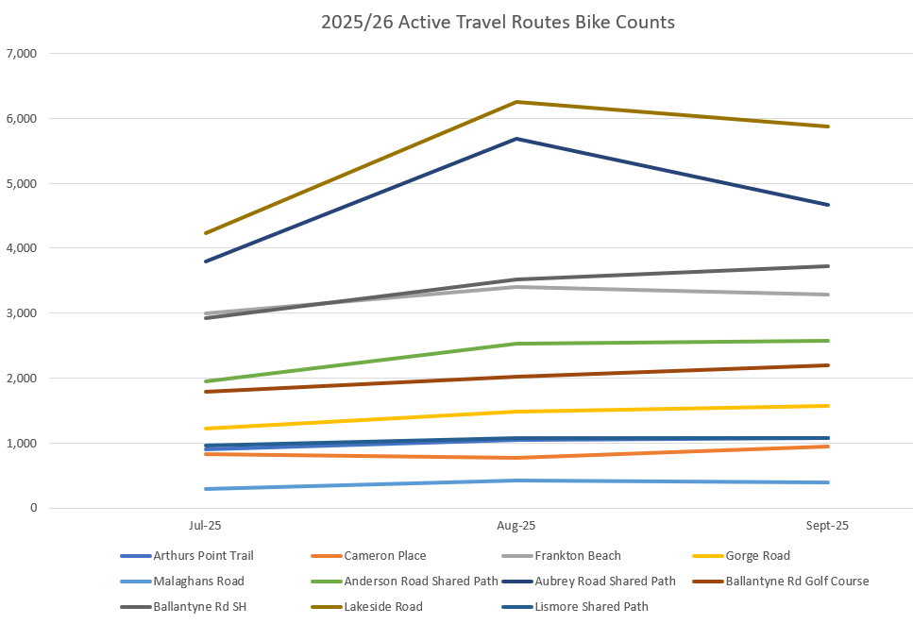
2025/26 Active Travel Routes Bike Counts

Slide 5
Number of People Walking
New counters have come online for the new year of reporting. This means that total counts are not directly comparable to 2024/25.
Queenstown Pedestrian Counters Q1 total movements
Arthurs Point Trail * – 6,653
Cameron Place – 6,032 (3% ↑ on Q1 2024/25)
Gorge Road – 6,898 (missing data for Q1 2024/25)
Malaghans Road – 1,400 (14% ↓ on Q1 2024/25)
Wānaka Pedestrian Counters Q1 total movements
Anderson Road Shared Path * – 6,109
Aubrey Road Shared Path – 8,520 (8% ↓ on Q1 2024/25)
Ballantyne Rd Golf Course * - 6,497
Ballantyne Rd SH * - 22,877
Lakeside Road – 39,175 (10% ↑ on Q1 2024/25)
Lismore Shared Path * – 9,215
Total Pedestrian Counts for Q1 2025/26 – 113,376
* New counter for 2025/26 reporting
Data sourced from designated Active Travel (Commuter) pedestrian and scooter counters.

Slide 6
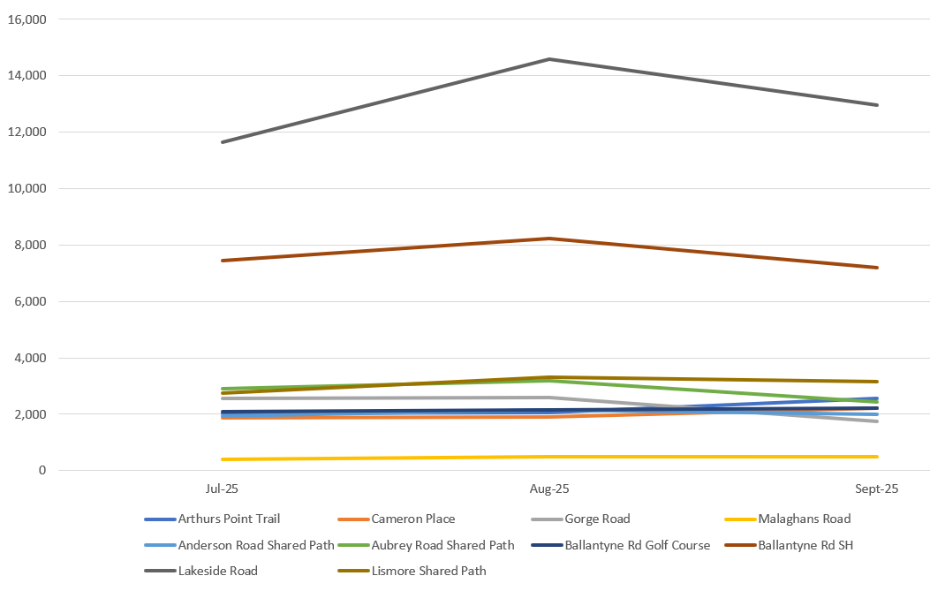
2025/26 Active Travel Routes Pedestrian Counts

Slide 7
Bus Patronage in Queenstown
Queenstown Bus Service
Queenstown bus patronage for 2024/25 is 1,966,086 trips – representing an increase of 4% from 2023/24.
Orbus patronage data for 10 of the 12 months of the year was at a record high for the Queenstown network, with the remaining 2 months (February and March 2025) both at 99% of the previous patronage records.
The annual total is also a record for Queenstown, with almost 2 million passenger trips.
While patronage continues to perform strongly, year-on-year growth is at a lower level than 2023/24 due to the very high rate of growth in that Financial Year.
Data reported by Otago Regional Council at Public and Active Transport Committee 3 September 2025

Slide 8
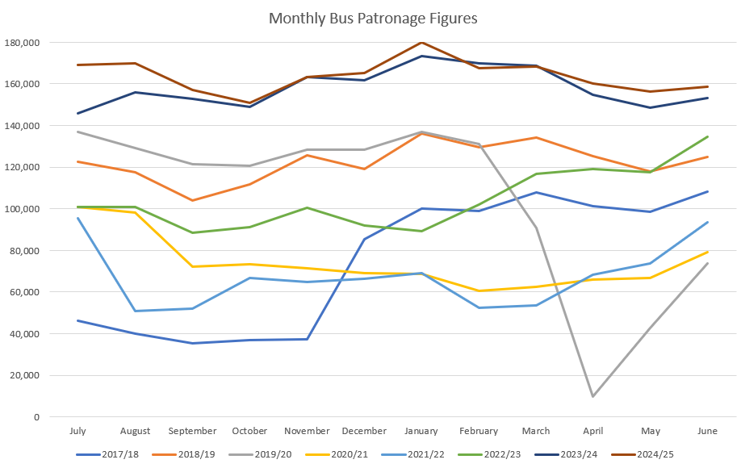
Monthly Orbus Patronage in QT
Data reported by ORC at PATC 3 September 2025
Data is for the public transport Orbus bus network in Queenstown

Slide 9
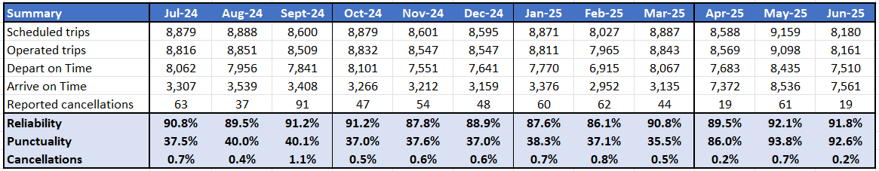
Orbus Public Transport Reliability
Reliability is the number of trips departing on time as a percentage of the total number of scheduled trips
Punctuality is the number of trips arriving on time as a percentage of the total number of operated trips
Cancellations are the number of cancelled trips as a percentage of the total number of scheduled trips
Scheduled trips are the number of trips that are meant to run each month (timetabled trips)
Operated trips is the actual number of trips that were run for the month due to cancellations or other reasons.
Over the 2024/25 year:
Average reliability is 89.8%
Punctuality saw an big increase in the last quarter, going from an average of 37.8% over Quarter 1 – 3 to an average of 90.8% in Quarter 4
A total of 605 trips were cancelled
Data reported by ORC for the Orbus PT network in Queenstown

Slide 10
Ferry Patronage in Queenstown
Queenstown Ferry Service
Total Queenstown ferry patronage for 2024/25 is 71,123 trips – representing a decrease of 4% from 2023/24.
Whilst this is continuing the downward pattern of patronage, a result of the impact of the withdrawal of half price fares, the rate of decline is flattening. November, February, April and May patronage exceeded the previous year, with December, January and March very close.
Bee Card fares on the Ferry have been fixed at $10 since July 2023, following most of the previous Financial Year at the 50% reduced price of $5. Cash fares are $14, having previously been $7. Therefore, the impact of the return to full fares is more keenly felt in dollar terms on the ferry service than the bus service.
Data reported by Otago Regional Council at Public and Active Transport Committee 3 September 2025

Slide 11
Traffic Count Data
The following slides represent Total Daily Vehicle Counts for all vehicle types in both directions
Traffic count data recorded by NZTA from 9 sites across the State Highway network in Wakatipu
The header for each graph reflects the location of the counter on SH6 or SH6A
This Quarter 1 report reflects counts through to 21 September 2025
Some key noticeable trends:
The Stanley St (SH6A) by Millenium Hotel counter is the only counter to show a substantial drop in traffic recorded - due to the opening of Stage 1 of the Arterial route at the end of January 2025.
There is also a slight decrease in Ladies Mile traffic counts,
Peak season traffic volumes on Frankton Road are reaching and exceeding the theoretical capacity.
The Southern Corridor counters are showing distinct increases in traffic volumes. Namely:
Kawarau Falls Bridge: For 1 January – 21 September 2025 the average daily traffic count is 21,126 vehicles, which is a 12.7% increase on the same period in 2024 which had an average of 18,746 vehicles per day.
In comparison to the same period in 2019 (pre-covid) this is an 81% increase.
SH6 South of Peninsula Road: For 1 January – 21 September the average daily traffic count increased by 14% from 14,928 in 2024 to 17,400 in 2025.

Slide 12
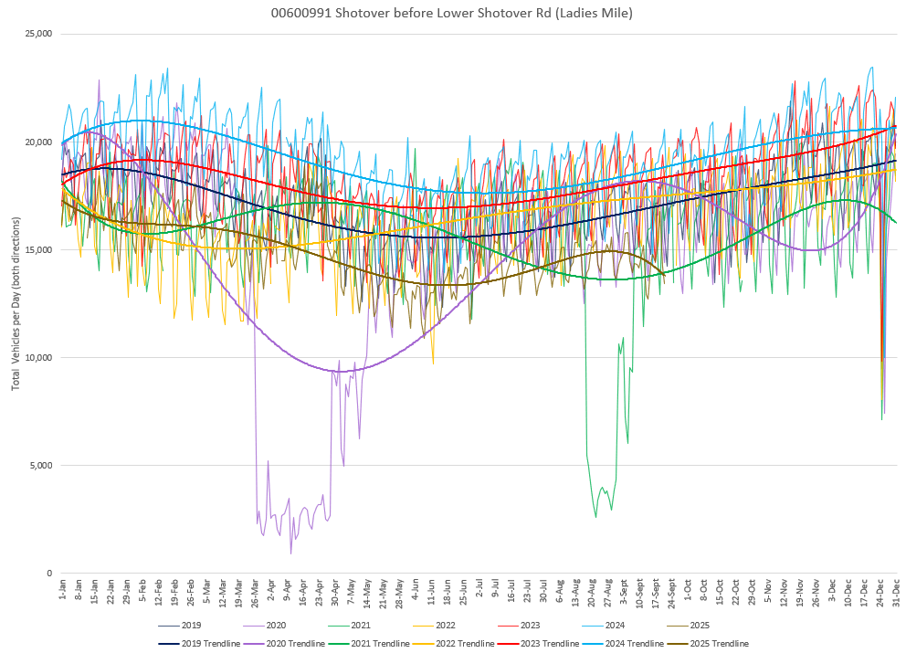
SH6 – Ladies Mile (East of Lower Shotover Rd)

Slide 13
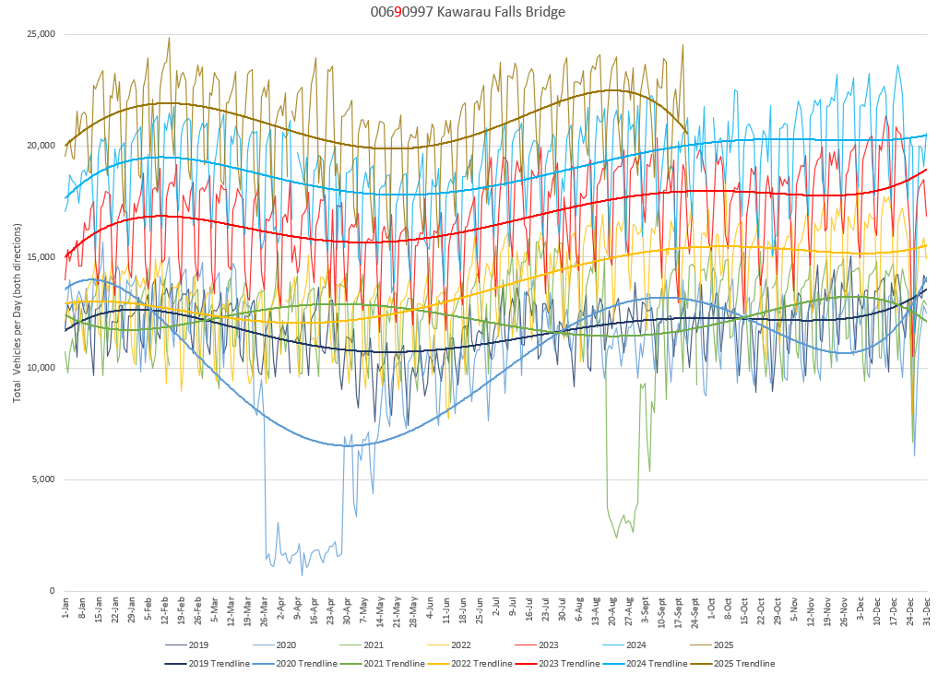
SH6– Kawarau Falls Bridge

Slide 14
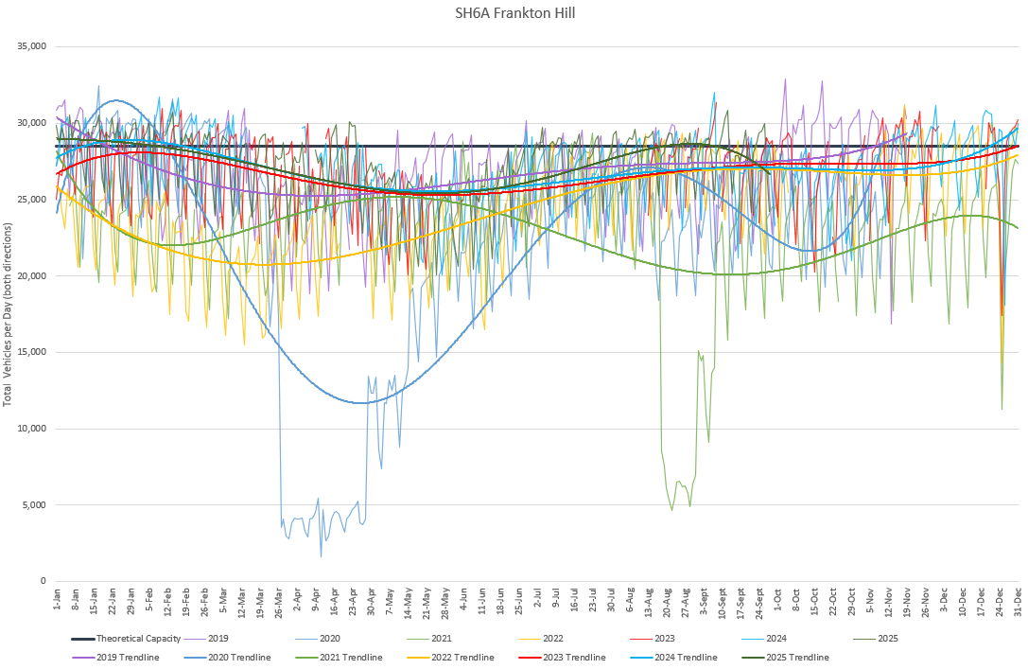
SH6A – Frankton Road

Slide 15
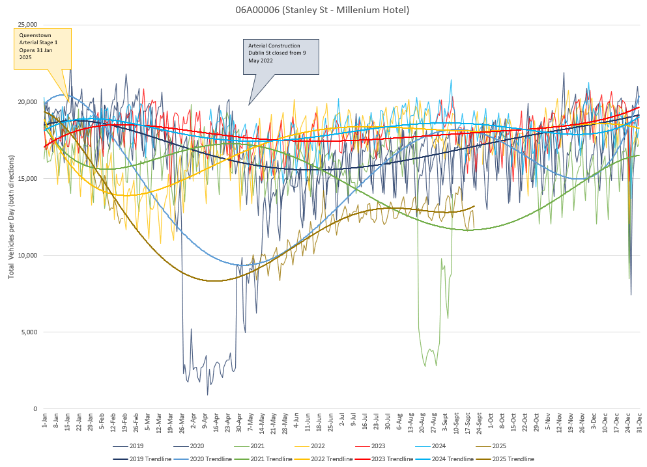
SH6A - Stanley St by Millenium Hotel

Slide 16
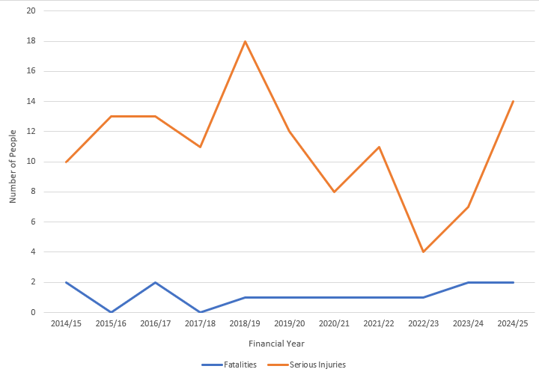
DSI’s on the Network
Annual change in number of fatalities and serious injuries on the local road network
Data from NZTA’s CAS system
Reporting is on local roads only i.e. does not include crashes that occur on private roads or on State Highways

Slide 17
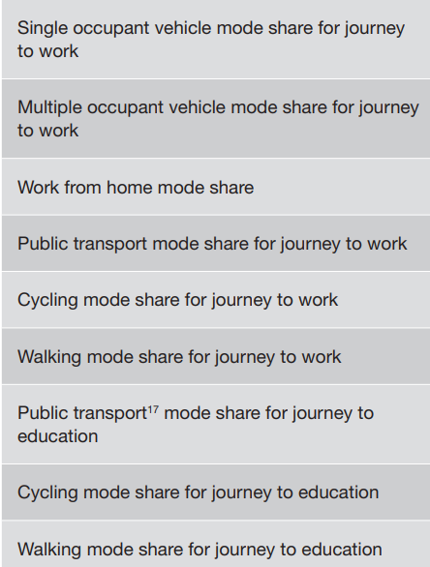
Reporting from Census Data
The data to track reporting against the adjacent Mode Shift Plan Performance Measures is sourced from the national Census data.
Data from the 2023 Census for these measures was released on 10 June 2025.
Data from both the 2018 and 2023 Census is on the following slides.
Data from 2023 for main means of travel to work and education was presented in two ways – by people living in Queenstown Lakes District, and people working in Queenstown Lakes District. The difference between the two categorisations for both work and education travel was negligible, and therefore only one graph is included for each in this report (people living in the district).
Main means of travel to work or education is the usual method a person used to travel the longest distance to their place of employment of education.
‘Usual’ is the type of transport used most often – i.e. the one used for the greatest number of days each week, month, or year. If there are two (or more) forms of transport used equally as often, the most recent form of transport was recorded.
‘Main’ is the type of transport used for the component of the journey that covers the longest distance.

Slide 18
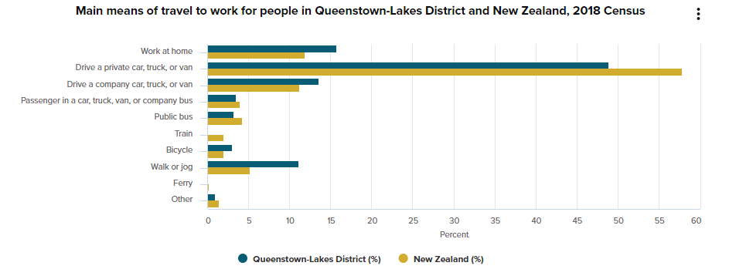
Mode Share for Journey to Work
Data from Stats NZ 2018 Census

Slide 19
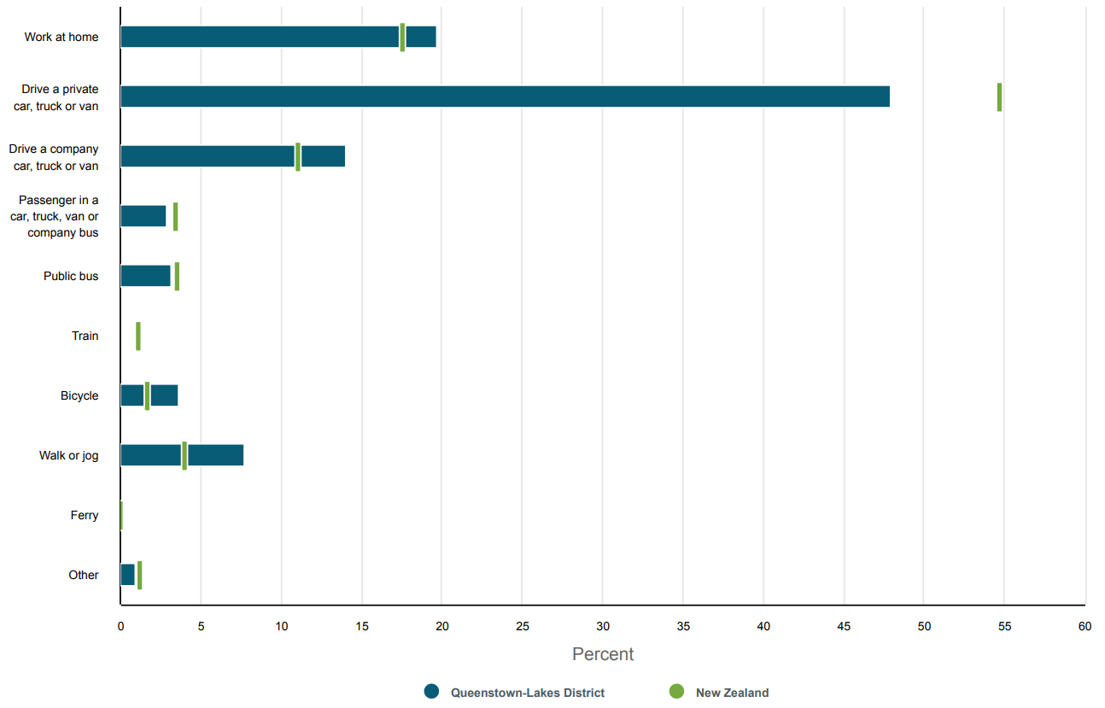
Mode Share for Journey to Work
Data from Stats NZ 2023 Census
Percentage of population by main means of travel to work, people living in Queenstown-Lakes District and New Zealand, 2023 Census

Slide 20
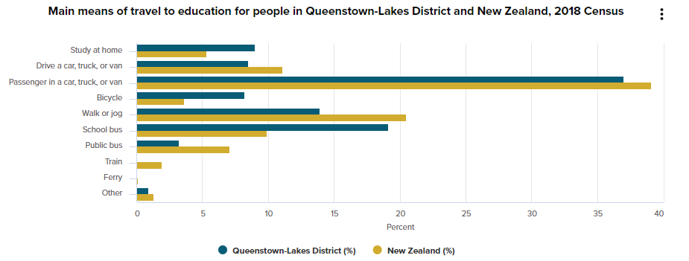
Mode Share for Journey to Education
Data sourced from Stats NZ 2018 Census

Slide 21
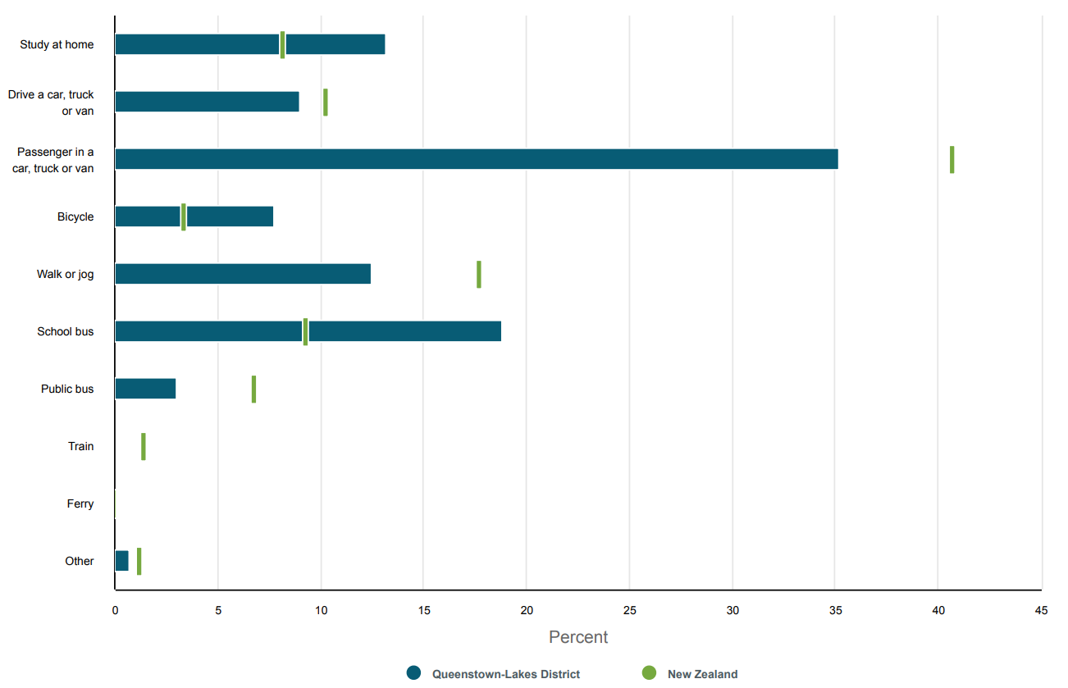
Mode Share for Journey to Education
Data sourced from Stats NZ 2023 Census
Percentage of population by main means of travel to education, people living in Queenstown-Lakes District and New Zealand, 2023 Census

Slide 22
Number of motor vehicles per household
Data sourced from Stats NZ 2023 Census
The following graph shows the number of motor vehicles for households in Queenstown – Lakes District (columns) compared with New Zealand (horizontal lines)
Number of motor vehicles identifies vehicles that are available for private use by the usual residents of private dwellings. These vehicles must be mechanically operational but not necessarily licensed or with a current warrant of fitness
Motor vehicles include:
Business vehicles available for private use by people in the dwelling
Cars, four-wheel drive vehicles, station wagons, trucks, vans, and other vehicles used on public roads
Hired or long-term leased vehicles
Vehicles temporarily under repair.
They do not include:
Farm vehicles not licensed for road use
Motorbikes or scooters
Vehicles used only for business
Vehicles that belong to visitors
Vehicles occasionally borrowed from another household.

Slide 23
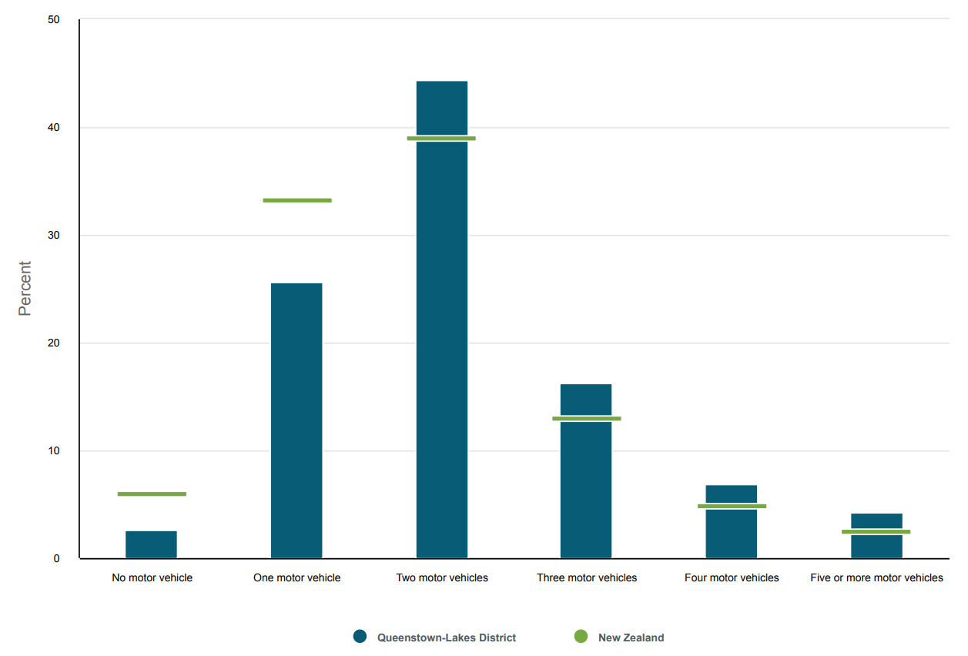
Number of motor vehicles per household
Data sourced from Stats NZ 2023 Census
Percentage of households by number of motor vehicles, Queenstown-Lakes District and New Zealand, 2023 Census

