Slide 1
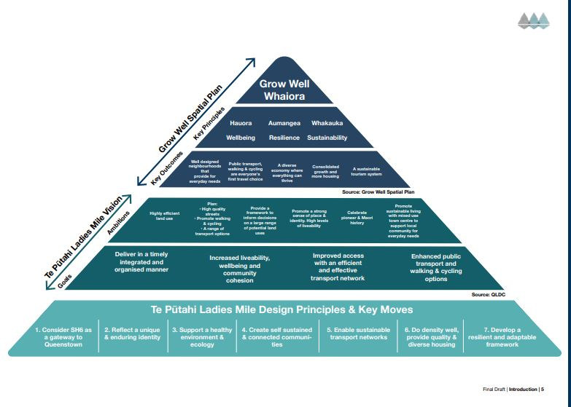
INTRODUCTION: The 3 Principles behind my reasoning
1/ Vision of the Masterplan
Ref.#1
Celine Austin Submission

Slide 2
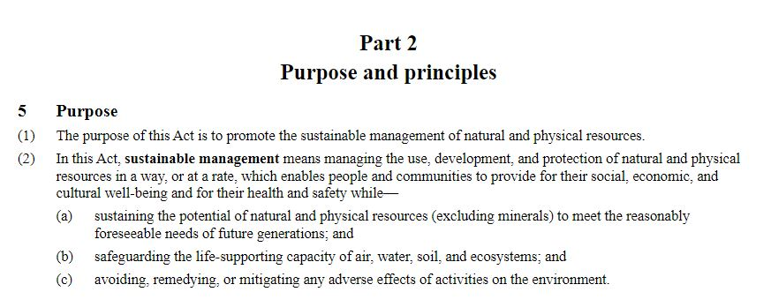
2/ RMA 1991: Part 2 - Purpose Ref.#2
Celine Austin Submission

Slide 3

3/ NZ Waste Strategy Vision 2050 Ref.#3
Celine Austin Submission

Slide 4
1/ KEY ISSUES OUTSIDE THE TPLM PERIMETER
A. Traffic congestion, active transport and modal shift
The point of focus and data analysis have been around SH6 West-East bound of Shotover Bridge. However traffic congestion is spread widely around the Wakatipu Basin, especially at peak times. This creates a ripple effect, affecting residents, tourists and tourist operators.
Active Transport - business case from 2019 Ref.#4 & 5
Route A2 and A8 which are key to active transport linking East to West Side of Shotover bridge haven’t been completed yet.
Route C7 doesn’t have the funding.

Slide 5
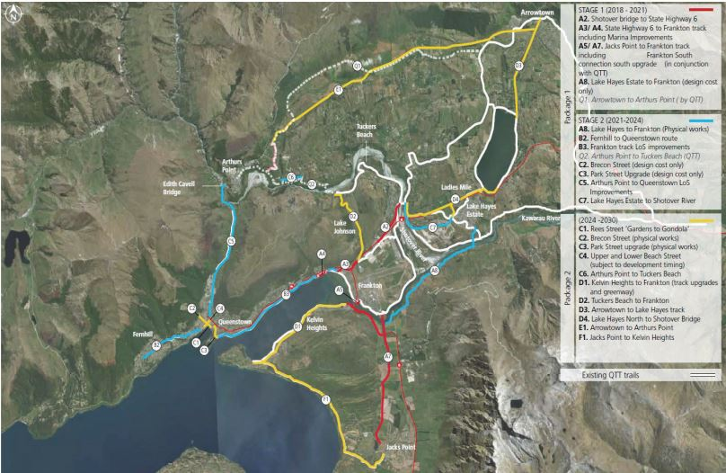
Ref.#4

Slide 6
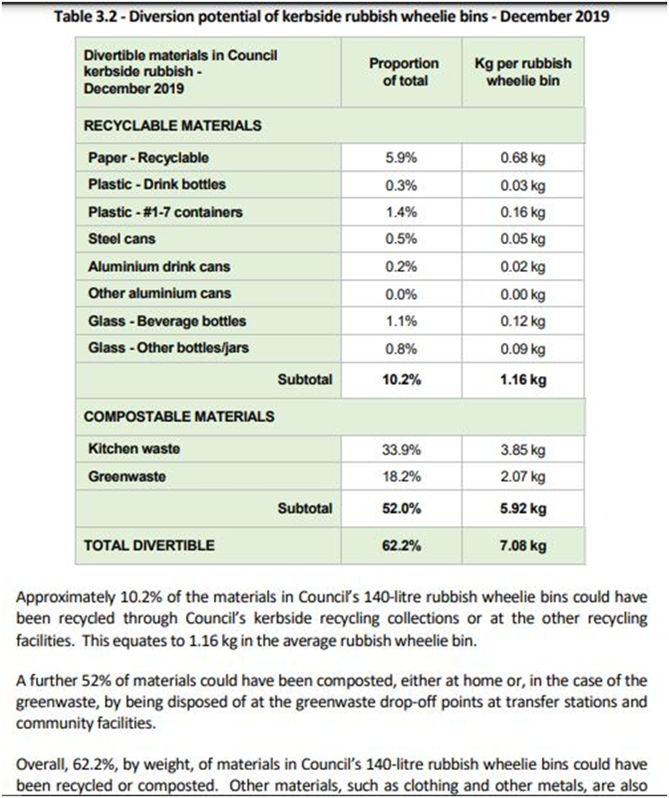
2. WASTE MANAGEMENT, RECYCLING and ORGANIC WASTE
52% of our waste are compostable Ref.#6
QLDC WMMP 2018 Ref.#7 preferred program was “focusing on glass and organics”
QLDC annual reports 2021 to 2023 Ref.#8 & #9 are still planning for organic waste collection and recycling centre upgrade
Celine Austin Submission

Slide 7

CONCLUSION
I have concerns that some key infrastructures in Queenstown are not already in place or being completed in the near future to insure Queenstown GROWS WELL in a SUSTAINABLE MANNER.
Fundamental Active Transport Network linking East- West side of Shotover Bridge
Recycling Centre relocation and upgrade
Kerbside organics collection
2018 Report - Sustaining tourism growth in Queenstown - Ref.#10
Celine Austin Submission

Slide 8
2/ KEY ISSUES WITHIN THE TPLM PERIMETER
A. The Provisions or Points I support
1. SH6/Stalker Road and SH6/Howards Drive intersection upgrades with managed traffic lights and speed reduction down to 60km/h. Ref.#11
2. Increase of the supermarket floor area. Ref.#12 I believe this should help residents to find competitive pricing within the TPLM commercial precinct and decrease utility trips to main Frankton shops.

Slide 9
B. The amended provisions I oppose
1. Reduction of the 75m setback adjacent to SH6 on QCC land. Ref.#13 and Ref.#14
As per Mrs Palmer explains, this is important to retain foraging open space in the South Side of SH6 especially for 3 specific birds, who are either nationally endangered or declining. I refer to N.3 TPLM principles of the triangle “Support a healthy environment and ecology”.
I’m asking to review the provision to keep the 75m setback as per original.
Celine Austin Submission

Slide 10
2. Maximum parking requirement and Residential Visitor Accommodation in HDR. Ref.#15
My concerns:
Queenstown is a semi-rural environment and most people have at least one car, especially families. Not enough parking space for residents may generate “wild” parking.
90 day RVA in HDR (instead of the 4 week option presented by Mr Brown) will likely attract tourists with private vehicles.
CONCLUSION: I would like either the parking ratio to be reviewed to suit the amended provision or to keep the RVA in HDR down to 4 week.
Celine Austin Submission

Slide 11
C. The Provisions I would like to add
1. Provisions for easy access to 3 pin power sockets in parking areas, so EVs and e-bikes can easily be charged.
2A. Provisions to have more certainty regarding the staging of delivery of infrastructure and development.
2B. Provisions to enhance the development of the education facilities and commercial precinct before the residential area.
Ref.#16 - Mr Smith conclusion summarizes my view.
Celine Austin Submission

Slide 12
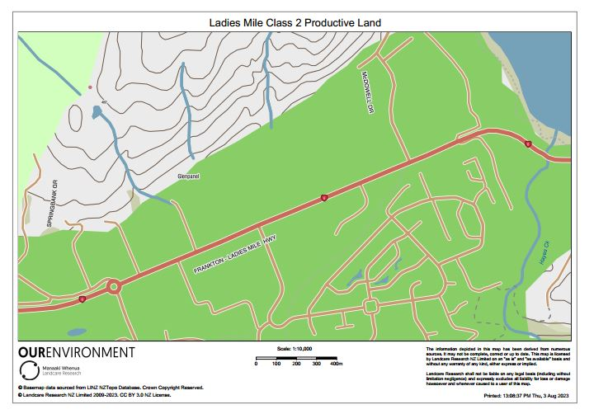
3. Provision for a Community garden especially for High Density Residents
49.2.2 Objective – Development achieves a range of residential intensity and diversity of housing choice to promote affordable homes, a self-sustaining community, and efficient use of urban land.
Ref.#17 - NPS-HPL Class 2
Celine Austin Submission

Slide 13
CONCLUSION:
I support the vision of Te Pūtahi Ladies Miles Masterplan. I can see the benefits it could bring to our community. However I have concerns that its success relies on specific staging phases involving multiple stakeholders and that it could easily fall through.
Thank you for your consideration

Slide 14
TPLM References:
#1 - Page 11- https://www.qldc.govt.nz/media/l5bnkx1o/1-appendix-a-te-putahi-final-draft-masterplan-report-pages-i-to-22.pdf
#2 - Resource Management Act 1991 - Part 2: Purpose and Principles
#3 - https://environment.govt.nz/what-government-is-doing/areas-of-work/waste/aotearoa-new-zealand-waste-strategy/
#4 - Page 16 - https://www.qldc.govt.nz/media/tgpdwrtf/a-watn-single-stage-business-case-pp1-16.pdf
#5 - https://www.qldc.govt.nz/services/transport-and-parking/way-to-go/whakatipu-active-travel-network
#6 - Page 15 - https://www.qldc.govt.nz/media/1vbfsmbr/final-1-0-queenstown-lakes-kerbside-waste-swap-2019.pdf
#7 - Page 17 - https://www.qldc.govt.nz/media/hcvlxe4w/waste-minimisation-and-management-plan-2018.pdf
#8 - Page 72 - https://www.qldc.govt.nz/media/2qmbdosc/qldc_annual-report_2021-2022_combined-101022-adopted.pdf
#9 - Page 84 & 86 - https://www.qldc.govt.nz/media/oqeh4xmz/qldc_annual-report_2022-2023_final-251023-adopted.pdf
#10 - Page 41 - https://www.qldc.govt.nz/media/nazhf4fd/1803-sustaining-tourism-growth-in-queenstown-final-report.pdf
#11 - Page 6 - Points17-18-19 https://www.qldc.govt.nz/media/0gsfxr2n/rebuttal-evidence-of-colin-shields-transport-dated-10-november-2023-appendix-a-included.pdf
#12 - Page 9 - Point 17 - https://www.qldc.govt.nz/media/tclpreir/section-42a-report.pdf
#13 - Page 23 - Point 83 - https://www.qldc.govt.nz/media/5oln5gfx/rebuttal-evidence-of-jeffrey-brown-planning-dated-10-november-2023.pdf
#14 - Page 4 - Point 12 - https://www.qldc.govt.nz/media/fymfovh5/rebuttal-evidence-of-dawn-palmer-ecology-dated-10-november-2023.pdf
#15 - Page 19 (Point 49.5.37) & Page 109 (Point 29.5.12A) - https://www.qldc.govt.nz/media/5oln5gfx/rebuttal-evidence-of-jeffrey-brown-planning-dated-10-november-2023.pdf
#16 - Page 23 - Point 13 Conclusion https://www.qldc.govt.nz/media/kfnlb0p4/dave-smith-traffic-waka-kotahi-submitter-62-20-oct-2023.pdf
#17 - Map HPL class 2 https://www.landcareresearch.co.nz/
Celine Austin Submission

